Slide 1
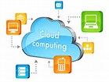
ITA : 6009 Cloud Computing Module 5 :Security in Cloud

Slide 2
Threats – methods doing attacks

Slide 3
Organizing the threats using STRIDE
Spoofing identity
Tampering with data
Repudiation (refuse to do with, dispute)
Information disclosure
Denial of service
Escalation of privilege

Slide 4
Spoofing identity
illegally obtaining access and use of another person’s authentication information
Man in the middle
URL phishing
Email address spoofing (email spam)

Slide 5
Tampering with data
Malicious modification of the data
Often hard and costly to detect
you might not find the modified data until some time has passed;
once you find one tampered item, you’ll have to thoroughly check all the other data on your systems

Slide 6
Repudiation
a legitimate transaction will be disowned by one of the participants
You sign a document first; and refused to confirm the signature
Need a trusted third party to mitigate

Slide 7
Information/data disclosure
an attacker can gain access, without permission, to data that the owner doesn’t want him or her to have.

Slide 8
Denial of service
an explicit attempt to prevent legitimate users from using a service or system. It involves the overuse of legitimate resources.
You can stop all such attacks by removing the resource used by the attacker, but then real users can’t use the resource either.

Slide 9
Escalation of privilege
an unprivileged user gains privileged access.
E.g. unprivileged user who contrives a way to be added to the Administrators group

Slide 10
Attackers

Slide 11
Who is the attacker?
Insider?
Malicious employees at client
Malicious employees at Cloud provider
Cloud provider itself
Outsider?
Intruders
Network attackers?

Slide 12
Attacker Capability: Malicious Insiders
At client
Learn passwords/authentication information
Gain control of the VMs
At cloud provider
Log client communication

Slide 13
Attacker Capability: Cloud Provider
What can the attacker do?
Can read unencrypted data
Can possibly peek into VMs, or make copies of VMs
Can monitor network communication, application patterns

Slide 14
Attacker motivation: Cloud Provider
Why?
Gain information about client data
Gain information on client behavior
Use the information to improve services
Sell the information to gain financial benefits

Slide 15
Attacker Capability: Outside attacker
What can the attacker do?
Listen to network traffic (passive)
Insert malicious traffic (active)
Probe cloud structure (active)
Launch DoS

Slide 16
Attacker goals: Outside attackers
Intrusion
Network analysis (network security)
Man in the middle: public key example
Req. pk_B
Req. pk_B
A
M
B
Pk_A: public key by A
Pk_B: public key by B
Pk_A’,Pk_B’: false public keys by M
Ret. Pk_B’
Ret. Pk_B

Slide 17
Man-in-Middle
A
M
B
Hello
Fool
Changes the Text

Slide 18


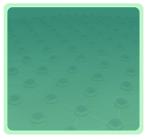



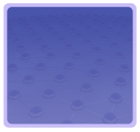

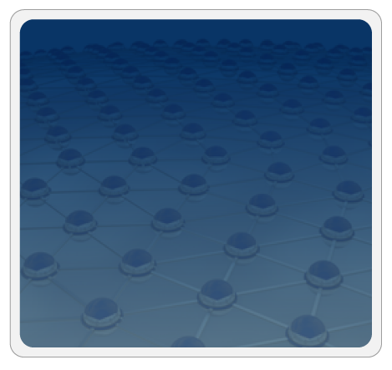



Trusted Zones
Insulate infrastructure from Malware, Trojans and cybercriminals
Anti-malware
Federate identities with public clouds
Identity federation
Cybercrime intelligence
Strong authentication
APP
APP
Tenant #2
OS
OS
Virtual network security
Control and isolate VM in the virtual infrastructure
Virtual Infrastructure
Insulate information
from other tenants
Data loss prevention
APP
APP
Tenant #1
OS
OS
Virtual Infrastructure
Insulate information from cloud providers’ employees
Segregate and control user access
Encryption & key mgmt
Access Mgmt
Tokenization
Cloud Provider
Physical Infrastructure
Physical Infrastructure
Security Info. & Event Mgmt
Enable end to end view of security events and compliance across infrastructures
GRC

Slide 19
Trusted Zone
Trusted zone is a combination of network segmentation and Identity Access Management (IAM) Controls
Trust zone defines physical , logical or virtual boundaries around network resources in a cloud environment

Slide 20
Identity Federation
It’s a system of trust between two parties for the purpose of authenticating users and conveying information needed to authorize their access to resources
It has trust relationship with external federation identity provides.
Ex: Azure AD, ADFS (Active Directory Federation Services)

Slide 21
Virtual Network Security
VS is used to secure data centres through isolation.
Virtual networks are connected to physical networks through various connection points or between end points that are managed by virtual network technology.

Slide 22
Access Management
AM is a cloud service that controls the permission and access for users and cloud resources.
Identity Access Management polices are sets of permission policies that can be attached to either users or cloud resources to authorize what they access and what they can do with it.

Slide 23
Security Info & Event Management (SIEM)
SIEM is a field within the field of computer security where software products and services combine security information management (SIM) and security event management (SEM).
SIEM provides real time analysis of security alerts generated by applications and network hardware.

Slide 24
Anti-Malware
This is a software that is created specifically to help detect, prevent and remove malware.
Eg. Anti-virus software

Slide 25
Cyber crime Intelligence
Involves collecting information on various cyber crime from a wide array of public, private and open sources and then process and analysing that information
Phishing, Identity theft, DoS

Slide 26
Strong Authentication
It’s a way of confirming a users identity when passwords are not enough
It confirms one’s identity and Access
Smart card, Bio Metric, Passport etc

Slide 27
Data Loss Prevention
DLP makes sure that user do not send sensitive or critical information outside the corporate network.
Detects potential data breaches and prevents them by monitoring, detecting and blocking sensitive data while in use.

Slide 28
Encryption and Key Management
It does the process of protecting the sensitive data using cryptographic techniques.
Key management protects, stores, backing up and organizing encryption keys

Slide 29
Tokenization & GRC
Tokenization works by replacing the actual valuable data elements with non-sensitive data events that have no exploitable value for data security purpose.
Governance Risk and compliance
Reduces risks and costs as well as duplication of effort
It does the process of review, development and implementation of security polices

Slide 30
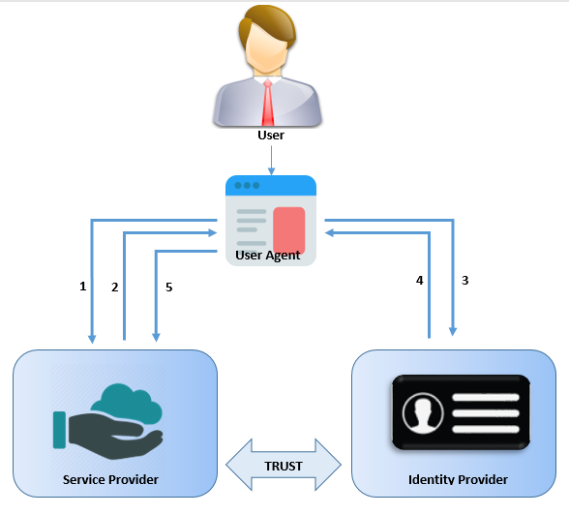

Slide 31
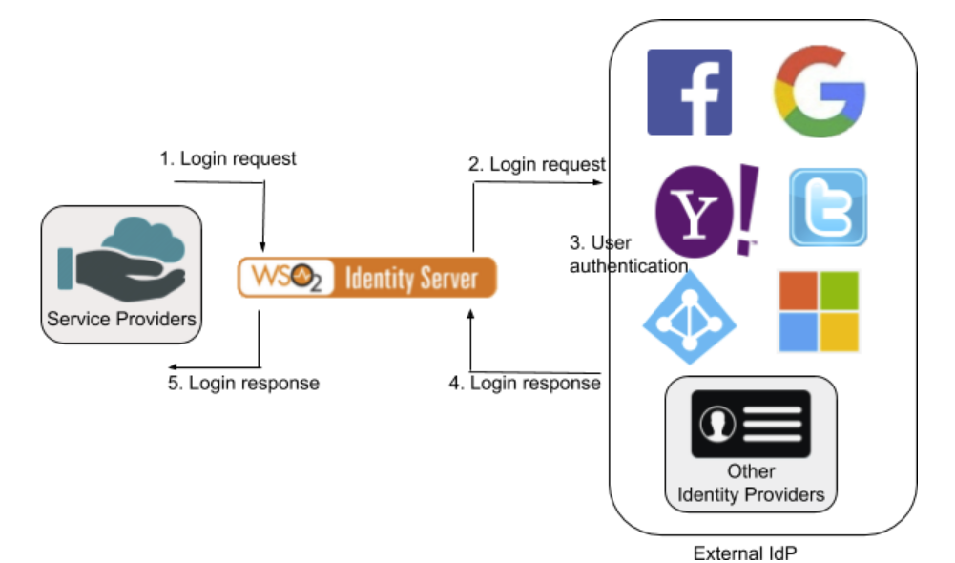

Slide 32
Access Control (ACM functions)
Who should have access to what resource? (Assignment of entitlements to users)
Why should the user have access to the resource? (Assignment of entitlements based on the user’s job functions and responsibilities)
How should you access the resource? (What authentication method and strength are required prior to granting access to the resource)
Who has access to what resource? (Auditing and reporting to verify entitlement assignments)

Slide 33
Control Statements
Control access to information.
Manage user access rights.
Encourage good access practices.
Control access to network services.
Control access to operating systems.
Control access to applications and systems.

Slide 34
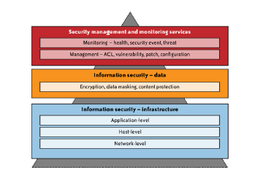
Security Management & Monitoring Scope

Slide 35
Infrastructure Security –Network Level
Public Cloud – Changing Security Requirements will need to change topology
ITIL Framework – Information Technology Infrastructure Library which gives important IT polices with checklist.
Risk Factors
Ensuring the confidentiality and integrity of your organization’s data-in-transit to and from your public cloud provider.(HTTPS)
Ensuring proper access control (authentication, authorization, and auditing) to whatever resources you are using at your public CSP.

Slide 36
Infrastructure Security
Ensuring the availability of the Internet-facing resources in a public cloud that are being used by your organization, or have been assigned to your organization by your public cloud providers . (i.e) DNS attacks.
(Prefix hijacking ;falsification of Network Layer Reach ability Information)
( DDOS attacks; making the service unavailable)
Replacing the established model of network zones and tiers with domains.
(Security Groups; Security Domains or Virtual Data Centers)
(Filtering the traffic based on IP address;packet types etc..)

Slide 37
Infrastructure Security- Host Level
In SAAS & PAAS, CSPs do not publicly share information related to their host platforms, host operating systems, and the processes that are in place to secure the hosts.
since hackers can exploit that information when they are trying to intrude into the cloud service.
it is common for CSPs to employ virtualization platforms, including Xen and VMware hypervisors, in their host computing platform architecture.
understand how the provider is using virtualization technology and the provider’s process for securing the virtualization layer.

Slide 38
Infrastructure Security- Host Level
IaaS customers are primarily responsible for securing the hosts provisioned in the cloud.
Virtualization software security
The software layer that sits on top of bare metal and provides customers the ability to create and destroy virtual instances.
It is important to secure this layer of software that sits between the hardware and the virtual servers.
(A vulnerable hypervisor could expose all user domains to malicious insiders)- Xen OpenSource,VMWare ESX, Microsoft Hyper-V, Oracle VM,
Customer guest OS or virtual server security
The virtual instance of an operating system that is provisioned on top of the virtualization layer and is visible to customers from the Internet; e.g., various flavors of Linux, Microsoft and Solaris. Customers have full access to virtual servers.

Slide 39
Virtual Server Security
Customers of IaaS have full access to the virtualized guest VMs that are hosted
A public IaaS, such as Amazon’s Elastic Compute Cloud (EC2), offers a web services API to perform management functions such as provisioning, decommissioning, and replication of virtual servers on the IaaS platform
Typically, the CSP blocks all port access to virtual servers and recommends that customers use port 22 (Secure Shell or SSH) to administer virtual server instances.

Slide 40
Virtual Server Security-Threats
Stealing keys used to access and manage hosts (e.g., SSH private keys)
Attacking un patched, vulnerable services listening on standard ports (e.g., FTP, NetBIOS,SSH)
Hijacking accounts that are not properly secured (i.e., weak or no passwords for standard accounts)
Attacking systems that are not properly secured by host firewalls
Deploying Trojans embedded in the software component in the VM or within the VM image (the OS) itself

Slide 41
Virtual Server Security (Recommendations)
Use a secure-by-default configuration. Harden your image and use a standard hardened image for instantiating VMs (the guest OS) in a public cloud.
Safeguard the private keys required to access hosts in the public cloud.
Include no authentication credentials in your virtualized images except for a key to decrypt the file system key.
Do not allow password-based authentication for shell access.
Require passwords for sudo* or role-based access (e.g., Solaris, SELinux).
Run a host firewall and open only the minimum ports necessary to support the services on an instance.
Run only the required services and turn off the unused services (e.g., turn off FTP, print services, network file services, and database services if they are not required).
Install a host-based IDS such as OSSEC or Samhain.
Enable system auditing and event logging, and log the security events to a dedicated log

Slide 42
End User Security
Protection measures include use of security software, such as anti-malware, antivirus, personal firewalls, security patches, and IPS-type software on your Internet-connected computer.
“the browser is your operating system”, ubiquitous “operating systems” for consuming cloud services.
To achieve end-to-end security in a cloud, it is essential for customers to maintain good browser hygiene.
users are encouraged to frequently check their browser vendor’s website for security updates, use the auto-update feature, and install patches on a timely basis to maintain end user security.

Slide 43
Data Security and Storage
is a customer’s data actually encrypted when it is stored in the cloud?
And if so, with what encryption algorithm, and with what key strength? It depends, and specifically, it depends on
which CSP you are using. For example, EMC’s Mozy Enterprise does encrypt a customer’s data.
However, AWS S3 does not encrypt a customer’s data. Customers are able to encrypt their own data themselves prior to uploading, but S3 does not provide encryption.
If a CSP does encrypt a customer’s data, the next consideration concerns what encryption algorithm it uses.

Slide 44
Symmetric Encryption
Symmetric encryption involves the use of a single secret key for both the encryption and decryption of data.
Only symmetric encryption has the speed and computational efficiency to handle encryption of large volumes of data.
Same concept of E-mail is also used in data storage encryption.

Slide 45
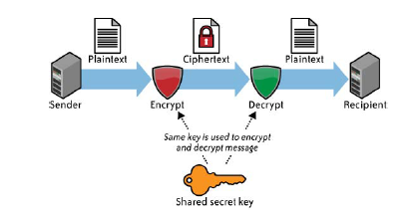
Symmetric Encryption

Slide 46
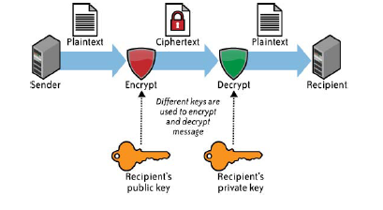
ASymmetric Encryption (Email but not in data storage)

Slide 47
Security VPC Management (Vulnerability, Patch, and Configuration )
The ability for malware (or a cracker) to remotely exploit vulnerabilities of infrastructure components, network services, and applications remains a major threat to cloud services.
CSPs are responsible for the vulnerability, patch, and configuration (VPC) management of the infrastructure. (networks, hosts, applications, and storage)
customers are not spared from their VPC duties and should understand the VPC aspects for which they are responsible.
A VPC management scope should address end-to-end security and should include customer-managed systems and applications that interface with cloud services.

Slide 48
Security Vulnerability Management
Vulnerability management is an essential threat management element to help protect hosts, network devices, and applications from attacks against known vulnerabilities.
Vulnerability management process that involves routine scanning of systems connected to their network, assessing the risks of vulnerabilities to the organization, and a remediation to address the risks.

Slide 49
Security Patch Management
scope of patch management responsibility for customers will have a low-to-high relevance in the order of SaaS, PaaS, and IaaS services.
Customers are responsible for managing patches for the whole stack of software (operating system, applications, and database) installed and operated on the IaaS platform.
Customers are also responsible for patching their applications deployed on the PaaS platform.
customers are relieved from patch management duties in a SaaS environment

Slide 50
Security Configuration Management
Protecting the configuration of the network, host, and application entails monitoring and access control to critical system and database configuration files, including OS configuration, firewall policies, network zone configuration, locally and remotely attached storage, and an access control management database.

Slide 51
Security as a Service
The first type comprises established information security vendors who are changing their delivery methods to include services delivered through the cloud.
The second type comprises start-up information security companies that are also emerging in this field as pure, play CSPs—that is, these companies
provide security only as a cloud service.
Don’t provide traditional client/server security
products for networks, hosts, and/or applications

Slide 52
Today’s Offerings
email filtering (including backup, archival, and e-discovery);
web content filtering;
vulnerability management;
identity-as-a-service (IDaaS).

Slide 53
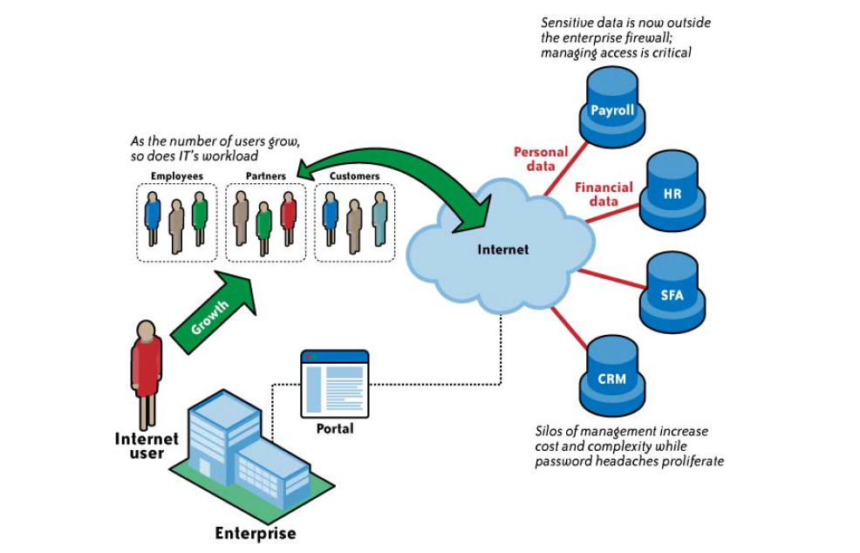
Identity Management-As-a-Service

Slide 54
Autonomic Computing

Slide 55
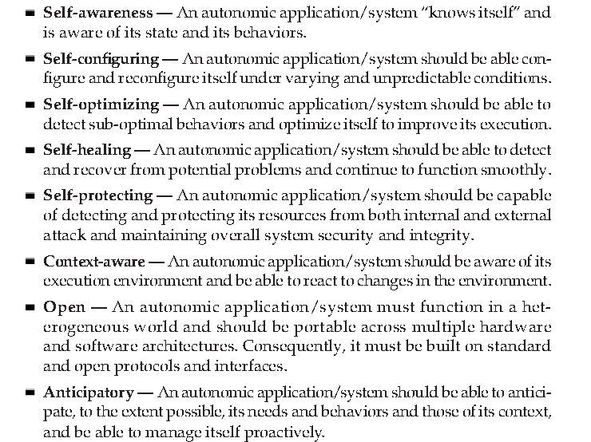
Characteristics

Slide 56
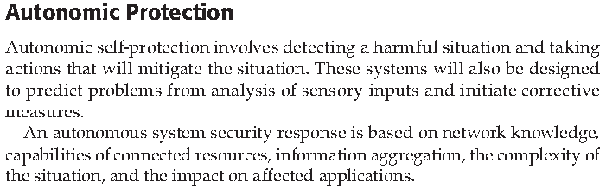

Slide 57
